Slide 1







Slide 2
Pothole Detection System
Submitted By Group 5:
Trinadh Bellam (811292241) tbellam@kent.edu
Vidya Pamidi (811296578) vpamidi@kent.edu
Krithika Reddy Pabbathi (811281744) kpabbath@kent.edu
Varshitha Karusala (811304448) vkarusal@kent.edu
Sai Krishna Nalluri (811286663) snallur2@kent.edu
Venkata sai prahlad dontha (811254988) vdontha@kent.edu

Slide 3
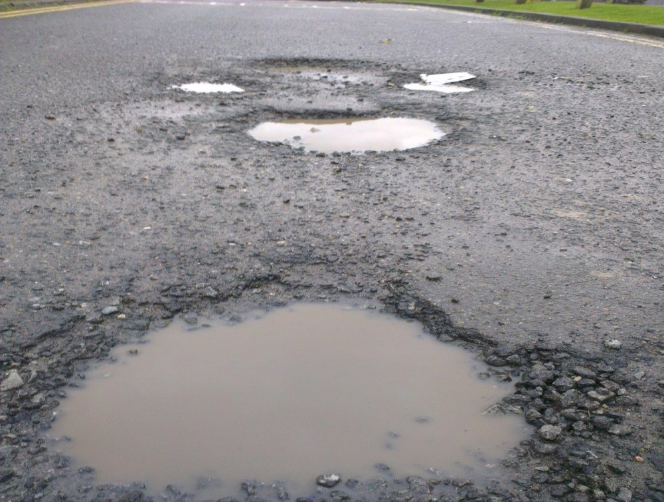
Problem Statement
Problem:
One of the main factors contributing to vehicle wear and tear and traffic accidents is the existence of potholes on the roadways. Small and big potholes are appearing on the roads in practically every city in the nation as a result of rising vehicle traffic and pollution. Manually gathering data on roadway damage is dangerous and time-consuming for people.

Slide 4
Existing Products
Pothole Detection Using Computer Vision and Learning
Pothole Detection Based on Disparity Transformation and Road Surface Modeling
Novel Feature Extractions for Reflection, Alligator Cracks and Potholes Road Surface Classification.
Detection of Asphalt Pavement Potholes and Cracks Based on the Unmanned Aerial Vehicle Multispectral Imagery

Slide 5
Existing Products
Drawbacks:
Accuracy and Precision: limitations in accurately identifying potholes, especially in challenging conditions such as poor lighting, diverse road textures.
Detection Methodology: Use traditional computer vision techniques, such as edge detection, texture analysis, or shape recognition, to identify potholes based on specific features like disparity, reflection, or cracks.

Slide 6
Proposed Product
The development of deep learning makes it possible to automatically identify road damage from the gathered road picture data. We offer a road pothole classification system based on a convolutional neural network using TensorFlow and Keras.

Slide 7
Product Value
Manually inspecting for potholes on roads is time-consuming and labour-intensive. This product automates the process which significantly reduces the time and resources required for inspection and maintenance.
Potholes might lead to accidents, injuries, and vehicle damage. Through this product we can identify the potholes and can take necessary actions to reduce the damage caused by potholes.

Slide 8
Technology
Programming Language: Python
Deep Learning Libraries: TensorFlow, Keras
Data Visualization Library: Matplotlib
Deep Learning Model: Convolutional Neural Network (CNN)
Graphical User Interface (GUI) Toolkit: Tkinter

Slide 9
Methodology
The dataset will be preprocessed such as Image reshaping, resizing and conversion to an array form.
Similar processing is also done on the test image. A dataset consisting of different Road Potholes is obtained, out of which any image will be used as a test image for the software.
The training dataset will be used to train the model, so that it will be able to identify the test images.
After the model is trained successfully, the software can identify the Road Pothole Classification image contained in the dataset.

Slide 10
Project Stages
2
4
Train a CNN Model
Design a GUI
1
3
5
Integrate the trained model in GUI
Iterate through all images in the dataset and resize the images
Save the model in as HDF5 file

Slide 11
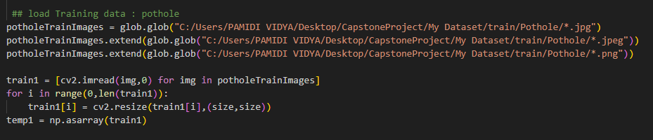
Project Stages
Iterate through all images in the dataset and resize the images.

Slide 12
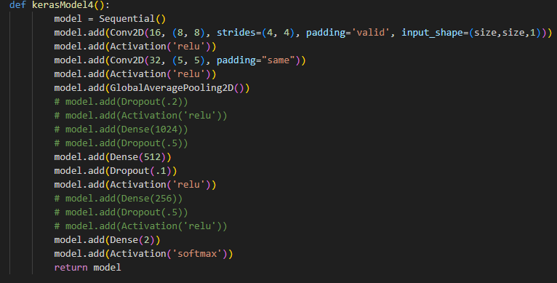
Project Stages
Train a CNN Model

Slide 13
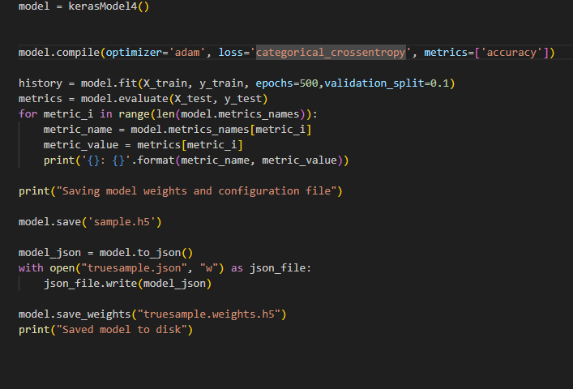
Project Stages
Save the model in as HDF5 file

Slide 14
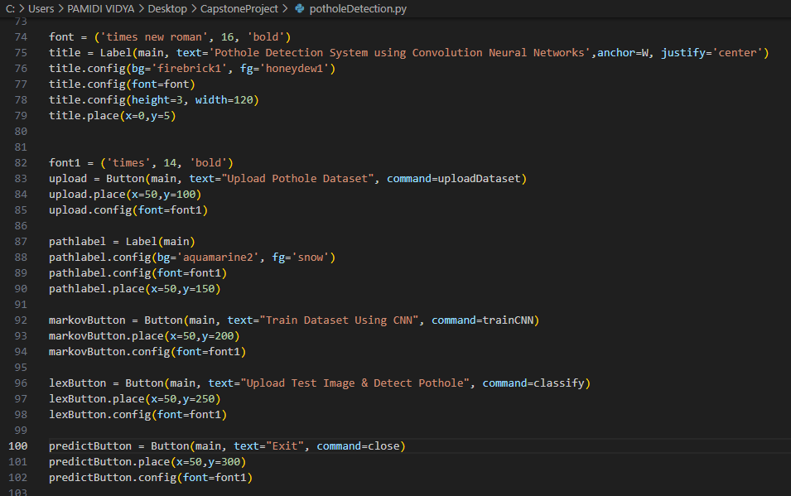
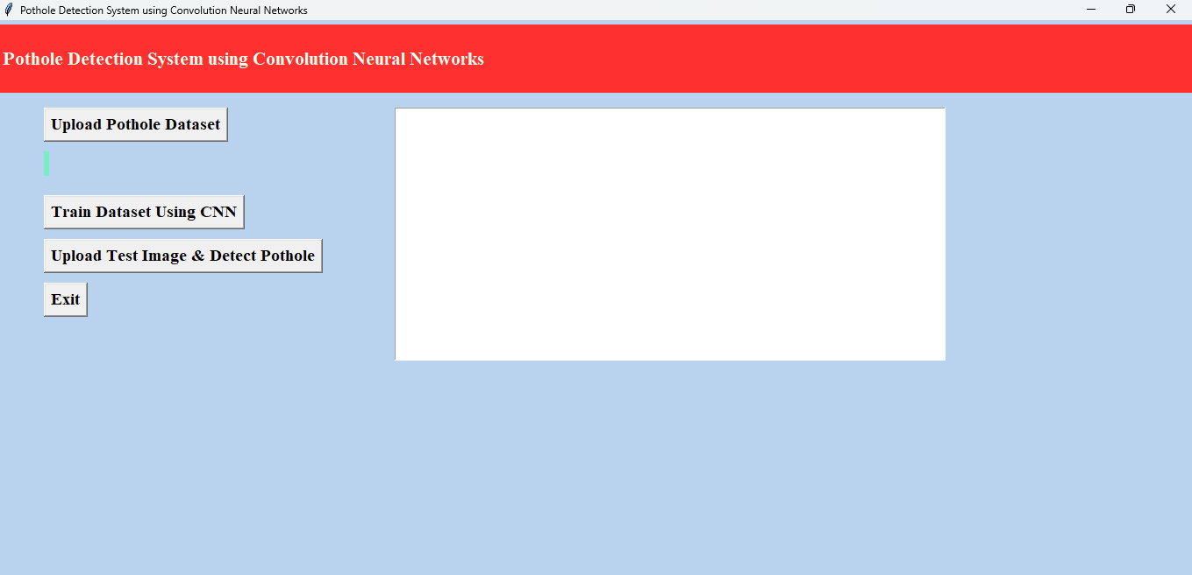
Project Stages
Design and Integrate the trained model in GUI
Code snippet for train dataset using CNN button

Slide 15
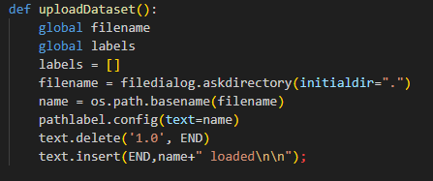
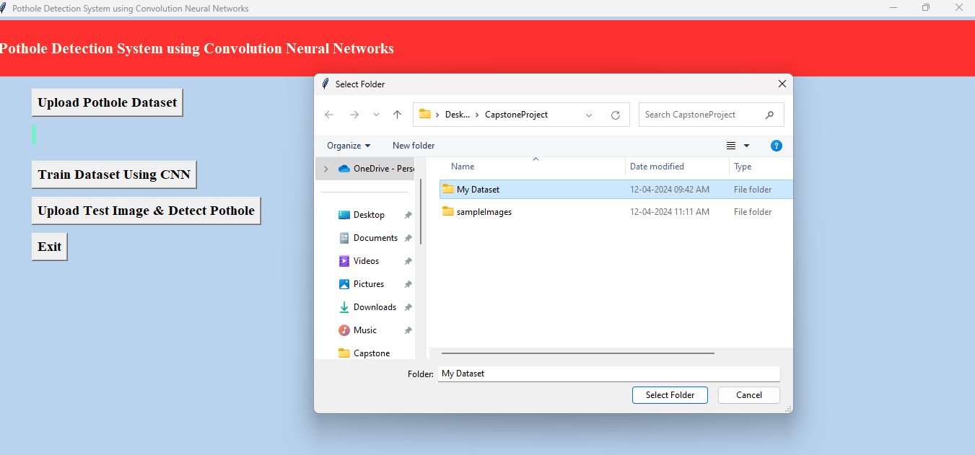
Project Stages
Design and Integrate the trained model in GUI
Code snippet for train dataset using CNN button

Slide 16
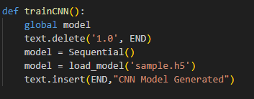
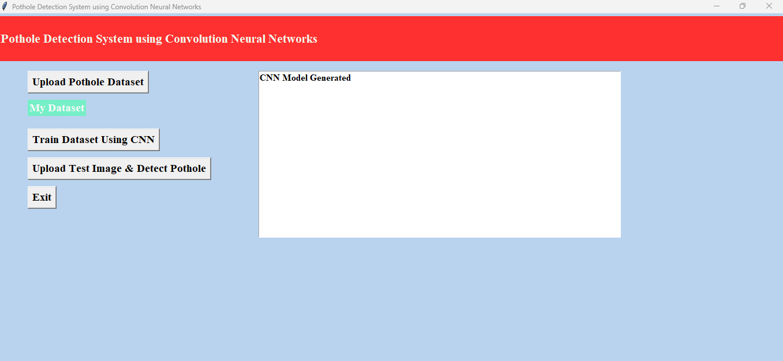
Project Stages
Design and Integrate the trained model in GUI
Code snippet for train dataset using CNN button

Slide 17
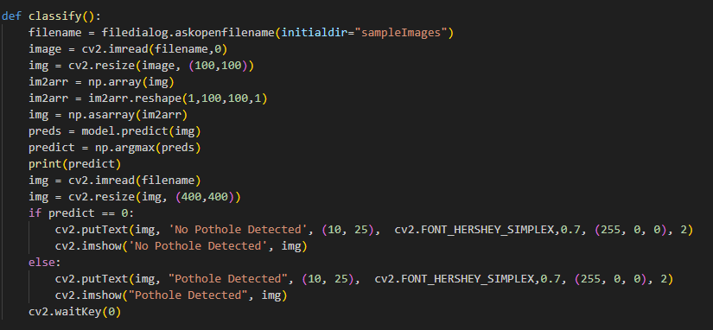
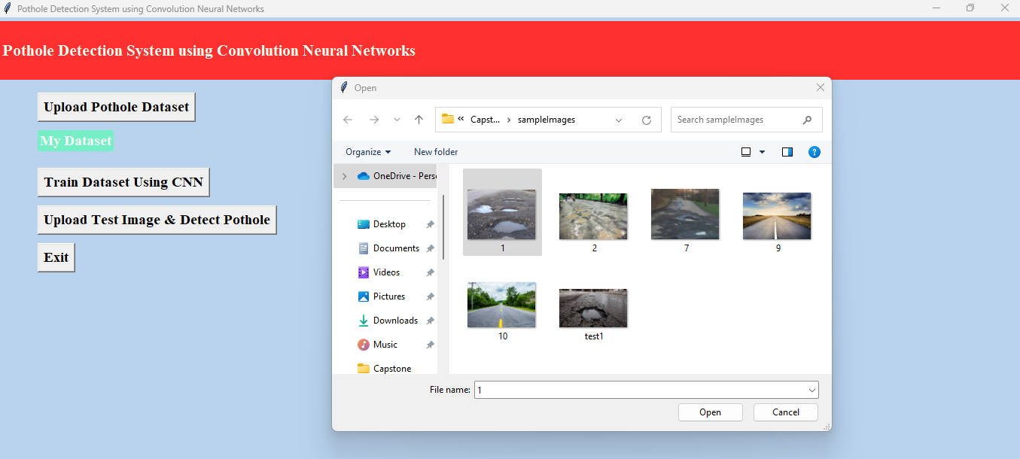
Project Stages
Design and Integrate the trained model in GUI
Code snippet for train dataset using CNN button

Slide 18
GUI

Slide 19
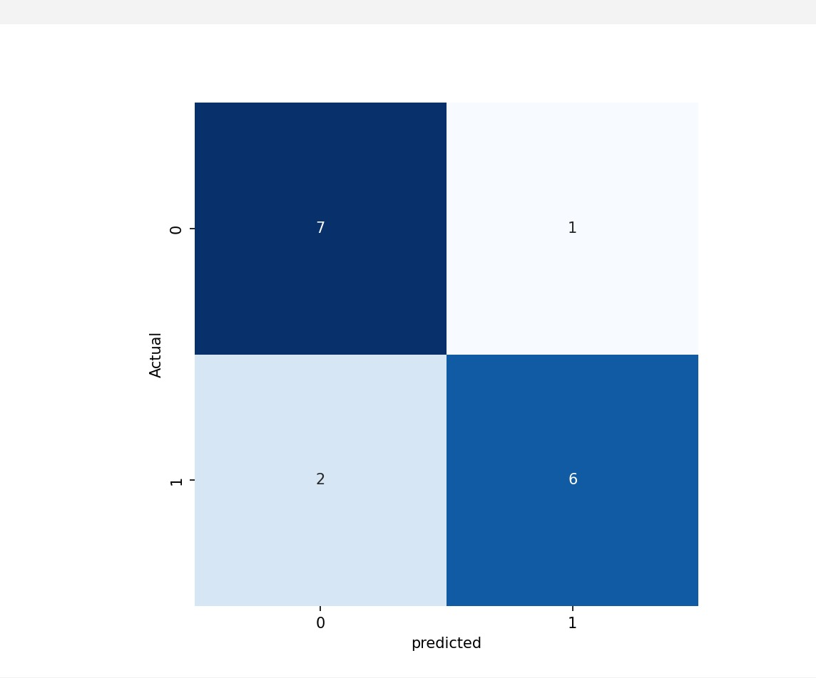
Performance Metrics
Confusion matrix and calculation of accuracy:
accuracy = (TP + TN) / (TP + TN + FP + FN)
= (7+6)/7+6+1+2
= 13/16
= 0.8125
Where,
TN: True Negative
FP: False Positive
FN: False Negative
TP: True Positive

Slide 20
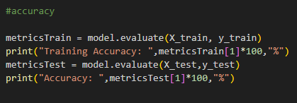
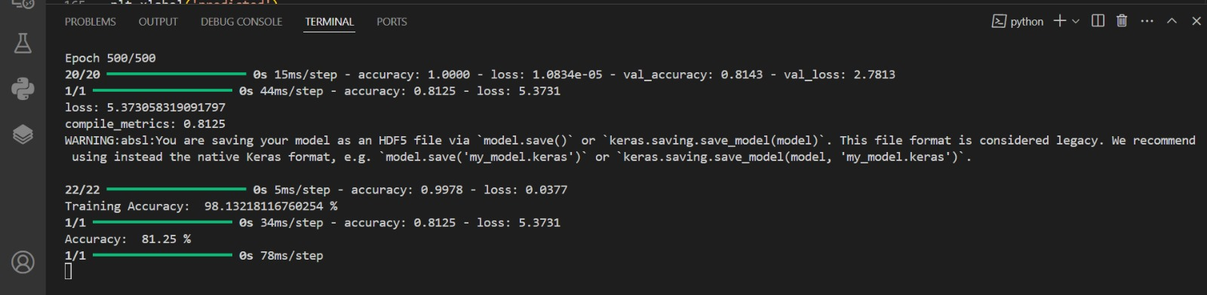
Performance Metrics
Accuracy

Slide 21
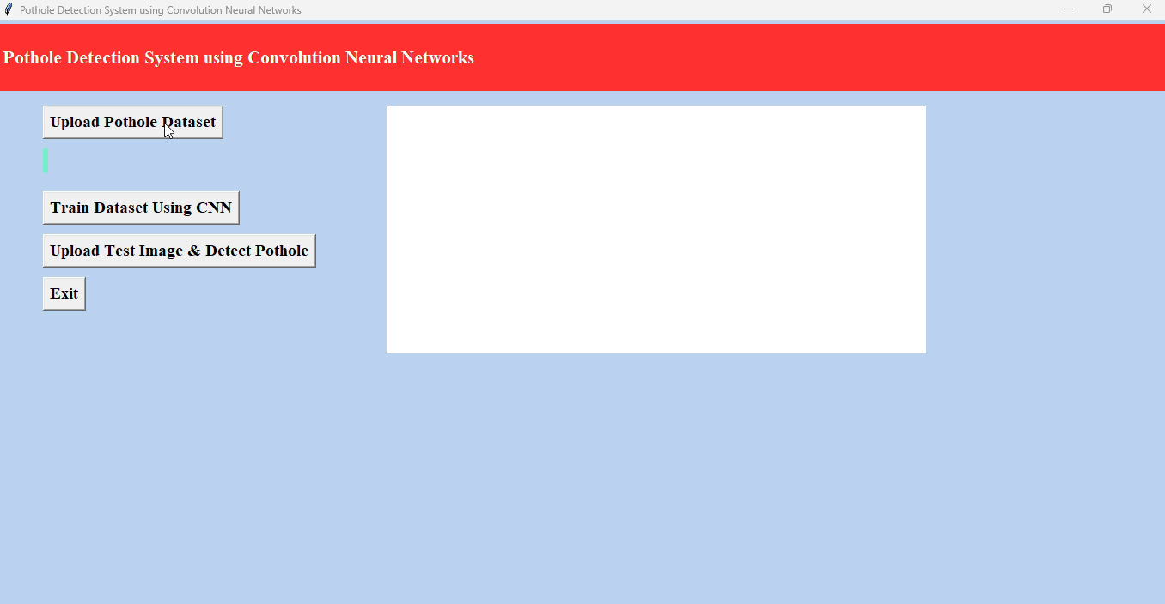
Project Demo

Slide 22
Future Work
Real-time implementation means creating a system that can quickly detect potholes while driving, working fast enough to keep up with the vehicle's speed.
This involves making the pothole detection system smaller, faster, and more efficient by using techniques like pruning, quantization, and parallelization.
This allows the system to give drivers immediate warnings about potholes as they drive.

Slide 23
GitHub Link
https://github.com/Group5-PotHoleDetectionProject/PotHoleDetection

Slide 24
References
Dhiman, A., & Klette, R. (2019). Pothole Detection Using Computer Vision and Learning. IEEE Transactions on Intelligent Transportation Systems, 21(8), 3536-3550. DOI: 10.1109/TITS.2019.2931297
Fan, R., Ozgunalp, U., Hosking, B., Liu, M., & Pitas, I. (2019). Pothole Detection Based on Disparity Transformation and Road Surface Modeling. *IEEE Transactions on Image Processing*, 29, 897-908. DOI: [10.1109/TIP.2019.2931297]
An, K.E., Lee, S.W., Ryu, S.K., Seo, D. (2018, January). Detecting a pothole using deep convolutional neural network models for an adaptive shock observing in a vehicle driving. In: *Consumer Electronics (ICCE), 2018 IEEE International Conference on*, pp. 1-2.
Moazzam, I., Kamal, K., Mathavan, S., Usman, S., Rahman, M. (2013). Metrology and visualization of potholes using the Microsoft Kinect sensor. In: *Proceedings of the 16th International IEEE Annual Conference on Intelligent Transportation Systems (2013)*, pp. 1284-1291.

Slide 25
Thank You!!

Slide 26


